Slide 1
AMAZON SALES
DATA ANALYSIS REPORT
Dipankar Modak
Akash Sahu

Slide 2
Problem Statement
Objective
Benefits
Help out to make better business decisions.
Help analyze customer trends and satisfaction, which can lead to new and better products and services.
Gives better insight of customers base.
Helps in easy flow for managing resources.
Sales management has gained importance to meet increasing competition and the need
for improved methods of distribution to reduce cost and to increase profits. Sales
management today is the most important function in a commercial and business
enterprise.
Develop a Report by Extracting-Transforming-Loading of data which contains Sales trend with respect to Year, Month, Quarter and find Some relationships through data to understand and Analyze the Facts.

Slide 3
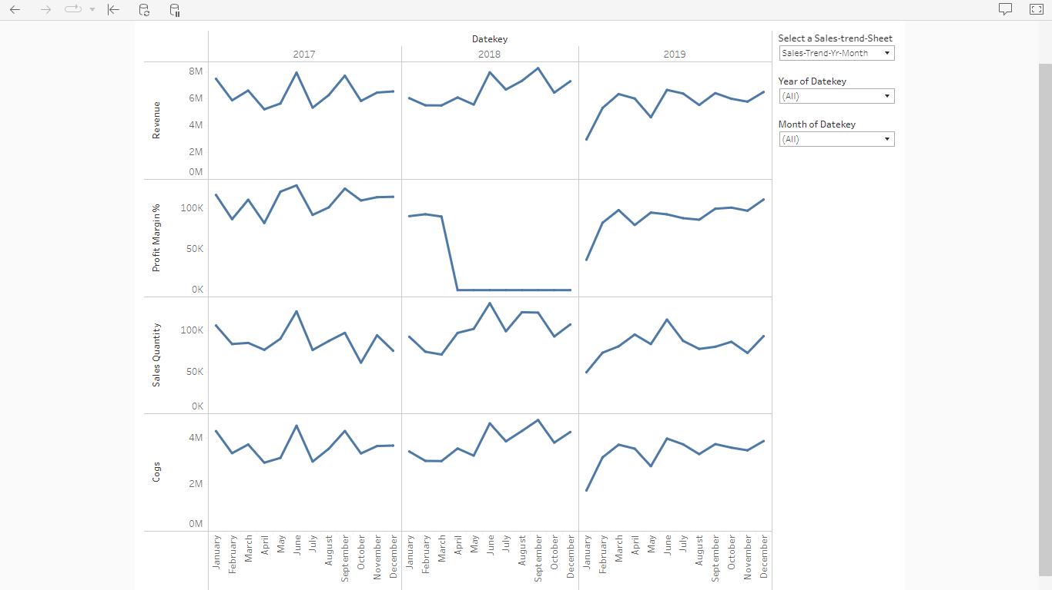
Sales Trend Dashboard(Year-Month)

Slide 4
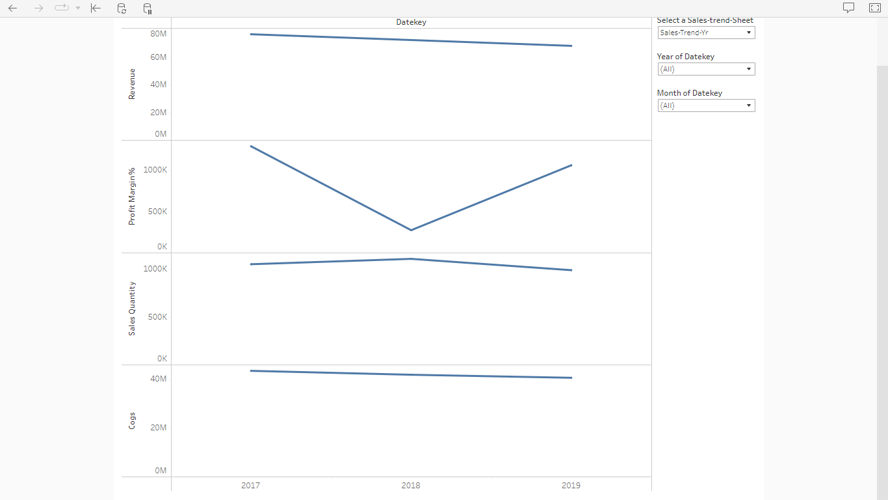
Sales Trend Dashboard(Yearly)

Slide 5
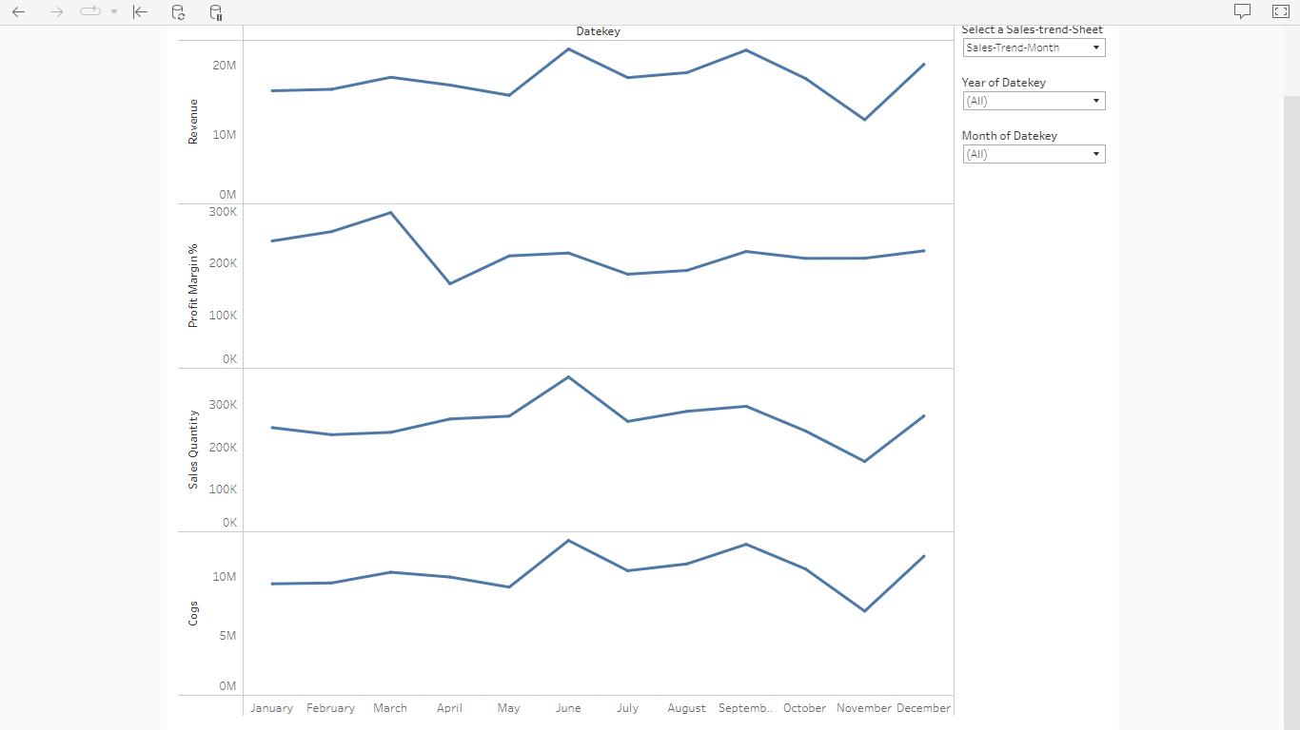
Sales Trend Dashboard(Monthly)

Slide 6
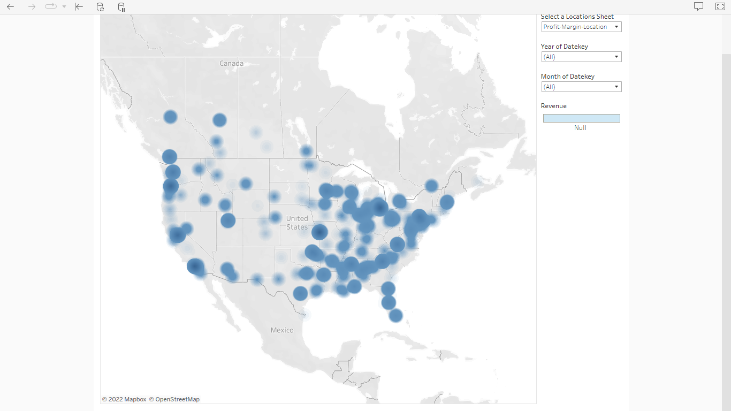
Profit Margin % based on Location

Slide 7
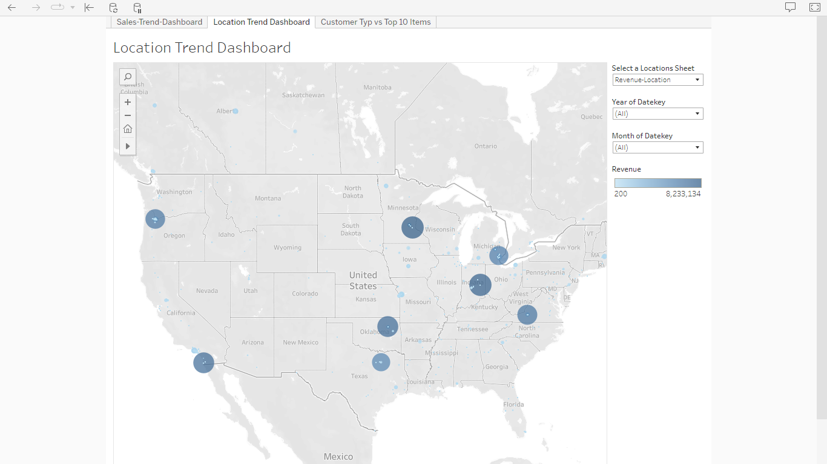
Revenue Generated based on Location

Slide 8
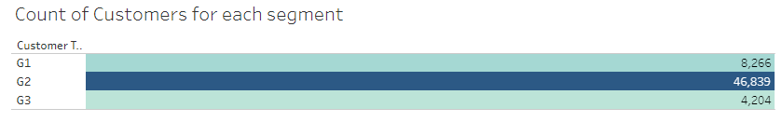
Count of customers per each segment

Slide 9
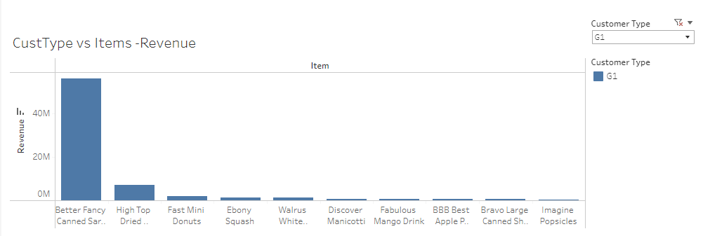
Top 10 products for customer type G1 by revenue

Slide 10
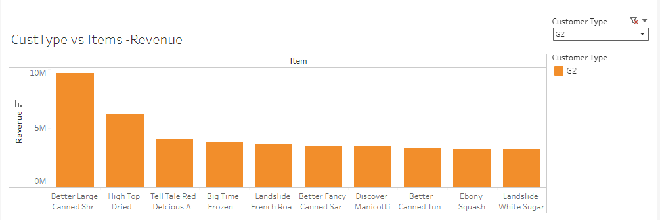
Top 10 products for customer type G2 by revenue

Slide 11
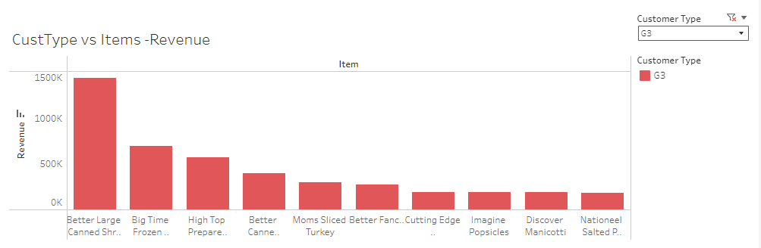
Top 10 products for customer type G3 by revenue

Slide 12
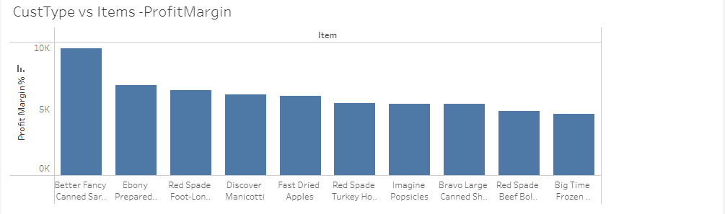
Top 10 products per customer type G1 by profit margin

Slide 13
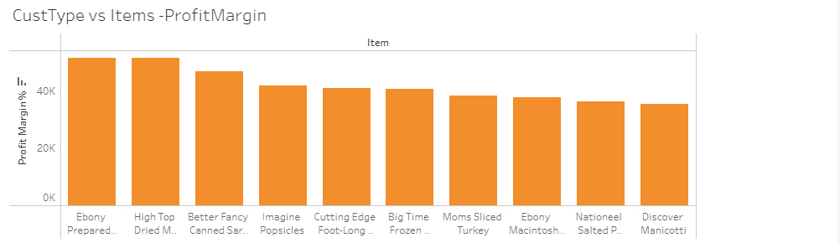
Top 10 products per customer type G2 by profit margin

Slide 14
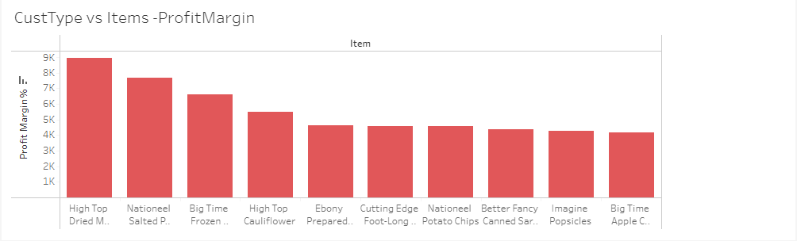
Top 10 products per customer type G3 by profit margin

Slide 15
In the year 2017 June month was the highest profit and revenue generating along with the highest sales, in the year 2018 September month was highest revenue generating while January was highest profit generating and June had the highest sales, in the year 2019 June month had the highest sales and revenue but December had the highest profit.
Profit margin % vs location map shows that the locations along the East coast of US has higher profit margin % compared to the West coast of US cities.
Customer type G2 is the highest profit generating and amongst all the customer segments G1,G2,G3.Ebony prepared salad is the highest profit generating product of all the products and is mostly purchases by customer of segment G1 and G2.
Conclusion

